Slide 1


Basic String Operations
Starting with python
Nikshep A Kulli
BYTE BY BYTE
TECH CHANNEL

Slide 2
Agenda:
Starting with python
Basic String Operations
String Slicing
Testing, Searching, and Manipulating Strings
BYTE BY BYTE
TECH CHANNEL

Slide 3
Python Strings:
Strings in python are surrounded by either single quotation marks, or double quotation marks.
'hello' is the same as "hello".
a = "Hello" print(a)
Testing, Searching, and Manipulating Strings
BYTE BY BYTE
TECH CHANNEL

Slide 4
Accessing individual letters:
a = "Hello, World!" print(a[1]) # it prints e , try it yourself
b = "Hello, World!" print(b[2:5])
BYTE BY BYTE
TECH CHANNEL

Slide 5
More String functions:
a = "Hello, World!" print(len(a))
print(a.upper())
print(a.lower())
print(a.replace("H", "J"))
BYTE BY BYTE
TECH CHANNEL

Slide 6
String Concatenation:
a = "Hello" b = "World" c = a + " " + b print(c)
BYTE BY BYTE
TECH CHANNEL

Slide 7
Accessing the individual characters in String:
To access an individual character in a string:
Use a for loop
Format: for character in string:
Useful when need to iterate over the whole string, such as to count the occurrences of a specific character
Use indexing
Each character has an index specifying its position in the string, starting at 0
Format: character = my_string[i]
BYTE BY BYTE
TECH CHANNEL

Slide 8
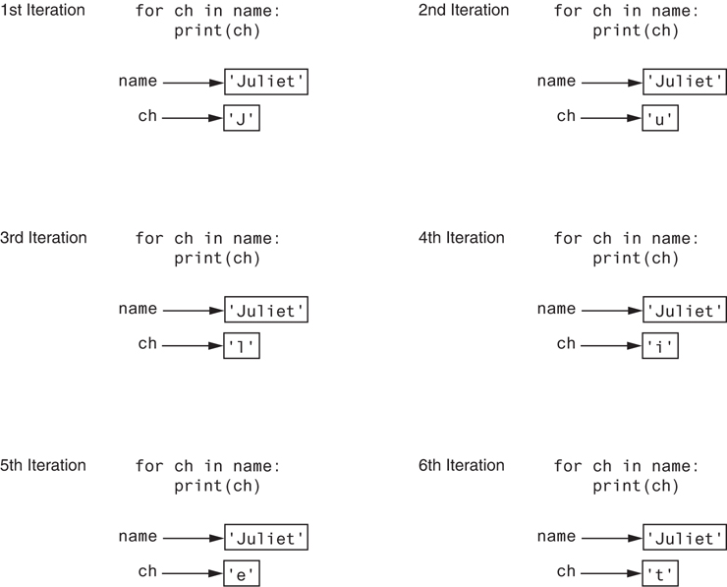
Accessing the individual characters in String:
BYTE BY BYTE
TECH CHANNEL

Slide 9


Accessing the individual characters in String:
Figure 8-2 String indexes
Figure 8-3 Getting a copy of a character from a string
BYTE BY BYTE
TECH CHANNEL

Slide 10
Accessing the individual characters in String:
IndexError exception will occur if:
You try to use an index that is out of range for the string
Likely to happen when loop iterates beyond the end of the string
len(string) function can be used to obtain the length of a string
Useful to prevent loops from iterating beyond the end of a string
BYTE BY BYTE
TECH CHANNEL

Slide 11
Accessing the individual characters in String:
Concatenation: appending one string to the end of another string
-Use the + operator to produce a string that is a combination of its operands
-The augmented assignment operator += can also be used to concatenate strings
-The operand on the left side of the += operator must be an existing variable; otherwise, an exception is raised
BYTE BY BYTE
TECH CHANNEL

Slide 12

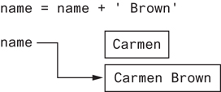
Accessing the individual characters in String:
Figure 8-4 The string ‘Carmen’ assigned to name
Figure 8-5 The string ‘Carmen Brown’ assigned to name
BYTE BY BYTE
TECH CHANNEL

Slide 13
String Slicing:
Slice: span of items taken from a sequence, known as substring
- Slicing format: string[start : end]
Expression will return a string containing a copy of the characters from start up to, but not including, end
If start not specified, 0 is used for start index
If end not specified, len(string) is used for end index
- Slicing expressions can include a step value and negative indexes relative to end of string
BYTE BY BYTE
TECH CHANNEL

Slide 14
Testing, Searching & Manipulating:
You can use the in operator to determine whether one string is contained in another string
General format: string1 in string2
string1 and string2 can be string literals or variables referencing strings
Similarly you can use the not in operator to determine whether one string is not contained in another string
BYTE BY BYTE
TECH CHANNEL

Slide 15
Testing, Searching & Manipulating:
Strings in Python have many types of methods, divided into different types of operations
- General format:
mystring.method(arguments)
Some methods test a string for specific characteristics
- Generally Boolean methods, that return True if a condition exists, and False otherwise
BYTE BY BYTE
TECH CHANNEL

Slide 16
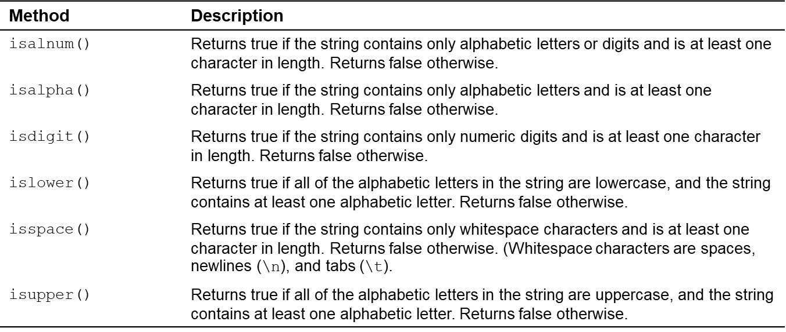
Accessing the individual characters in String:
Figure 8-1 Some String testing methods
BYTE BY BYTE
TECH CHANNEL

Slide 17
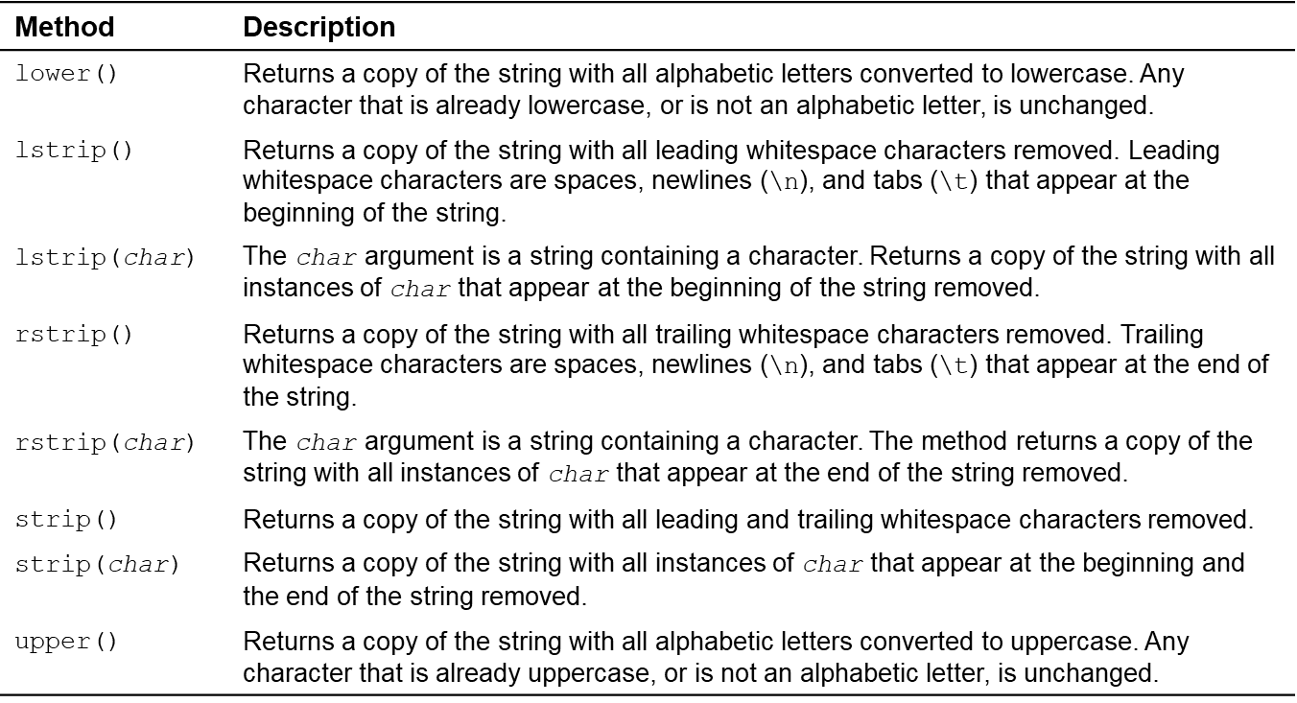
Accessing the individual characters in String:
Figure 8-2 Some String testing methods
BYTE BY BYTE
TECH CHANNEL

Slide 18
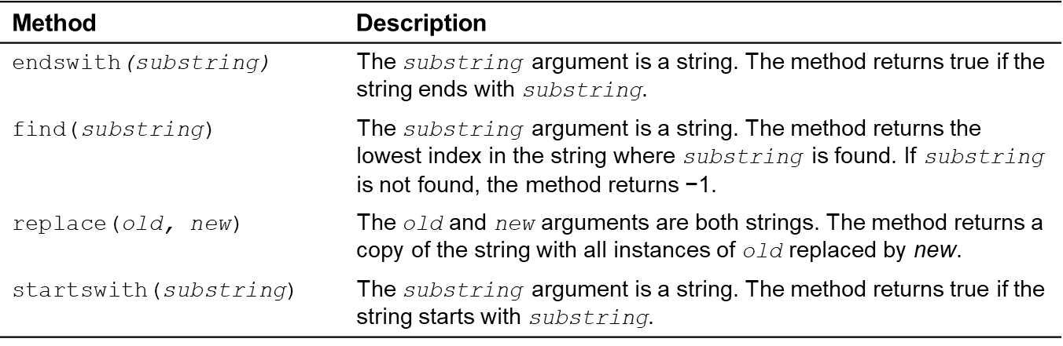
Accessing the individual characters in String:
Figure 8-3 Search replace methods
BYTE BY BYTE
TECH CHANNEL

Slide 19
Splitting a String (1 of 2)
split method: returns a list containing the words in the string
By default, uses space as separator
Can specify a different separator by passing it as an argument to the split method
BYTE BY BYTE
TECH CHANNEL

Slide 20
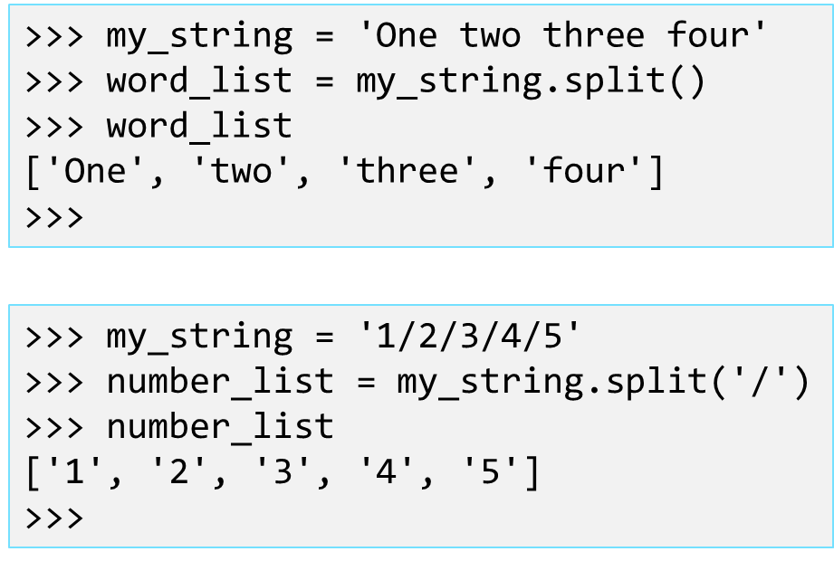
Splitting a String (2 of 2)
Examples:
BYTE BY BYTE
TECH CHANNEL

Slide 21
String Tokens (1 of 4)
Sometimes a string contains substrings that are separated by a special character:
-Example:
-This string contains the substrings peach, raspberry, strawberry, and vanilla
-The substrings are separated by the space character
-The substrings are known as tokens and the separating character is known as the delimiter
'peach raspberry strawberry vanilla'
BYTE BY BYTE
TECH CHANNEL

Slide 22
String Tokens (2 of 4)
Example:
This string contains the tokens 17, 92, 81, 12, 46, and 5
The delimiter is the ; character
'17;92;81;12;46;5'
BYTE BY BYTE
TECH CHANNEL

Slide 23
String Tokens (3 of 4)
Tokenizing is the process of breaking a string into tokens
When you tokenize a string, you extract the tokens and store them as individual items
In Python you can use the split method to tokenize a string
BYTE BY BYTE
TECH CHANNEL

Slide 24
String Tokens (4 of 4)
Examples:
>>> str = 'peach raspberry strawberry vanilla'
>>> tokens = str.split()
>>> tokens
['peach', 'raspberry', 'strawberry', 'vanilla']
>>>
>>> my_address = 'www.example.com'
>>> tokens = my_address.split('.')
>>> tokens
['www', 'example', 'com']
>>>
BYTE BY BYTE
TECH CHANNEL

Slide 25
Summary:
This chapter covered:
String operations, including:
Methods for iterating over strings
Repetition and concatenation operators
Strings as immutable objects
Slicing strings and testing strings
String methods
Splitting a string
BYTE BY BYTE
TECH CHANNEL

Slide 26
Wish you Happy Ganesh Chaturthi
Thank you!
Nikshep A Kulli

